Slide 1
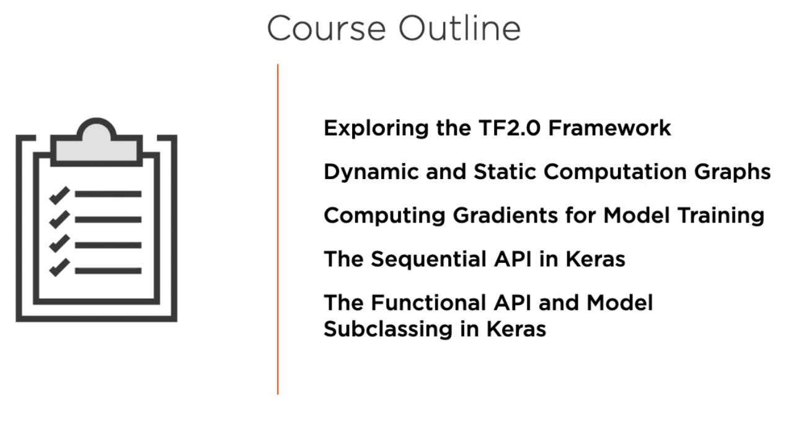

Slide 2
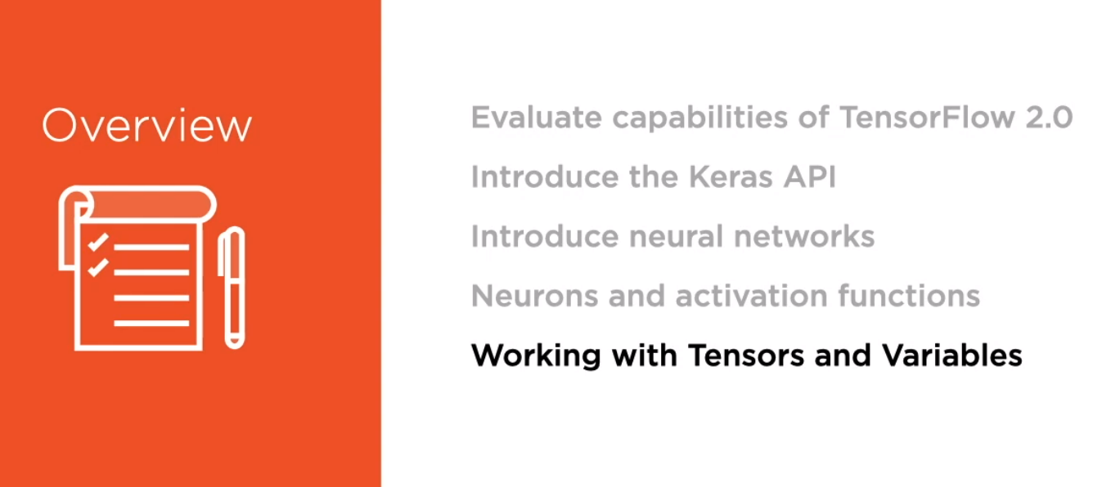
Module 1: Exploring the TensorFlow 2.0 Framework

Slide 3
Contents in Brief in Module 1
A. TensorFlow 1.x vs TensorFlow 2.0
B. Introducing Neural Networks
C. Neurons and Activation Functions
D. Working with Tensors and Variables

Slide 4

A. TensorFlow 1.x vs TensorFlow 2.0

Slide 5
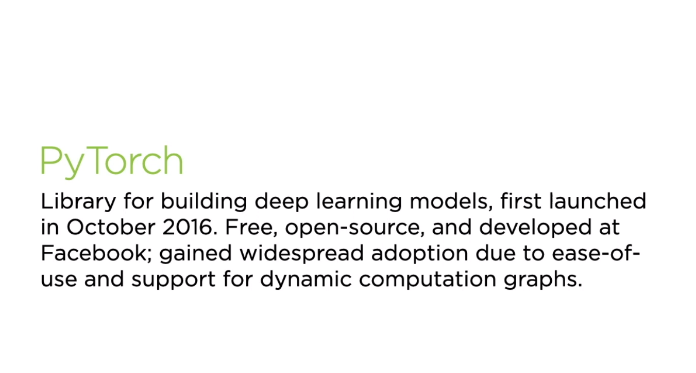
A. TensorFlow 1.x vs TensorFlow 2.0

Slide 6
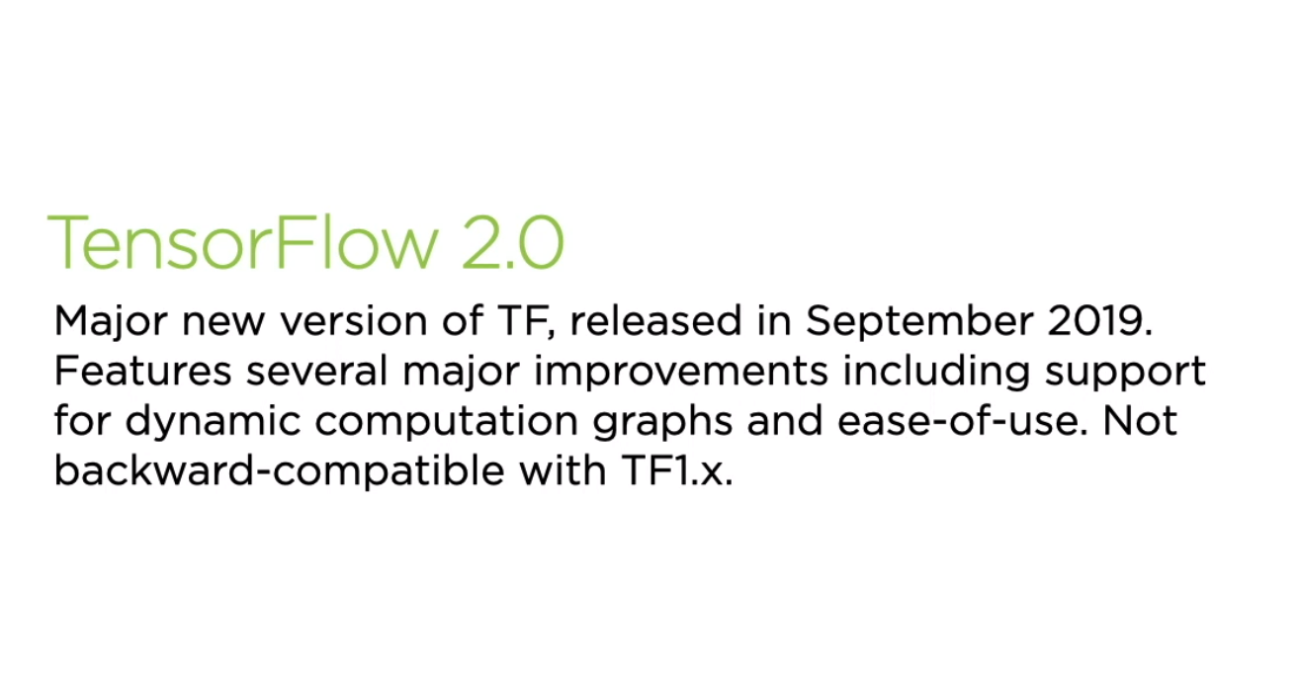
A. TensorFlow 1.x vs TensorFlow 2.0

Slide 7
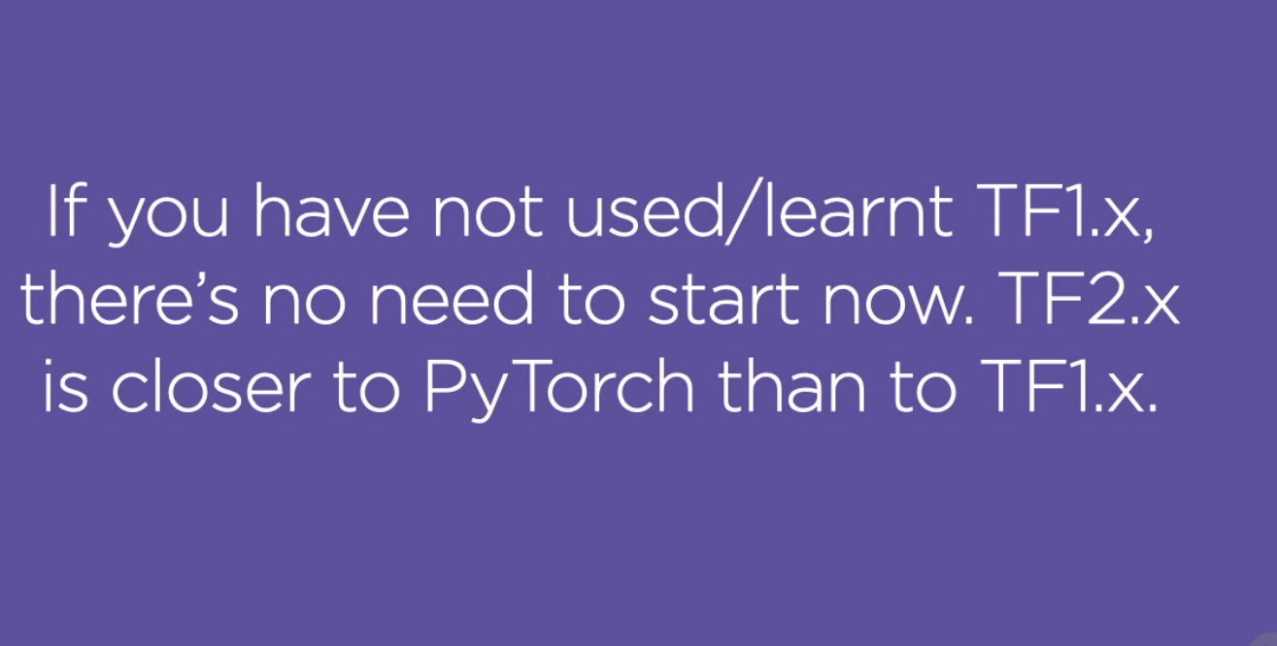
A. TensorFlow 1.x vs TensorFlow 2.0

Slide 8
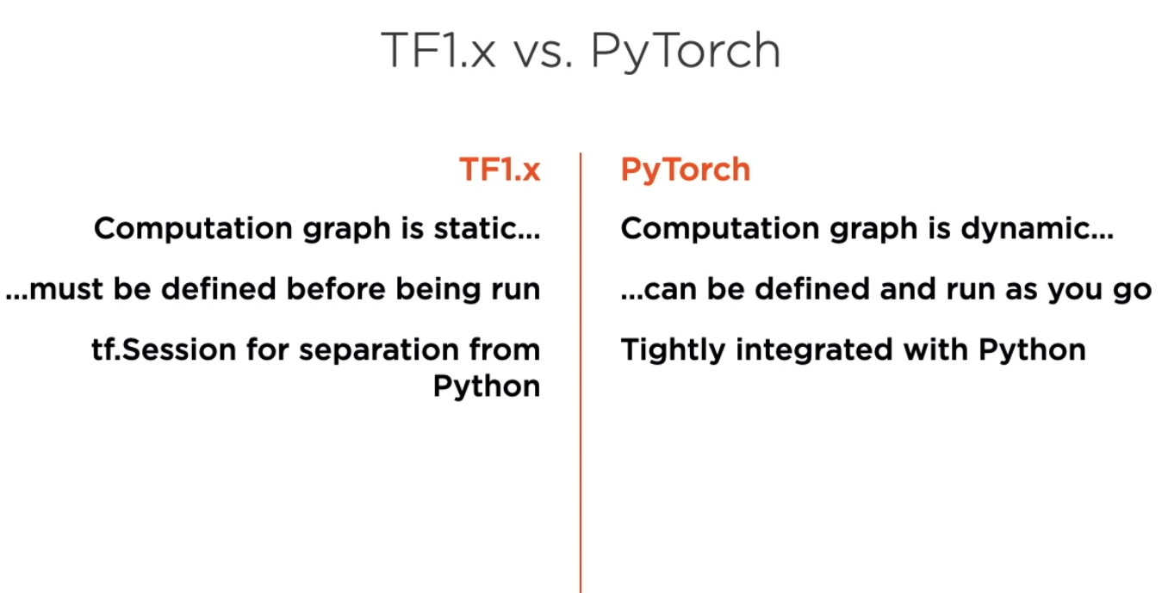
A. TensorFlow 1.x vs TensorFlow 2.0

Slide 9
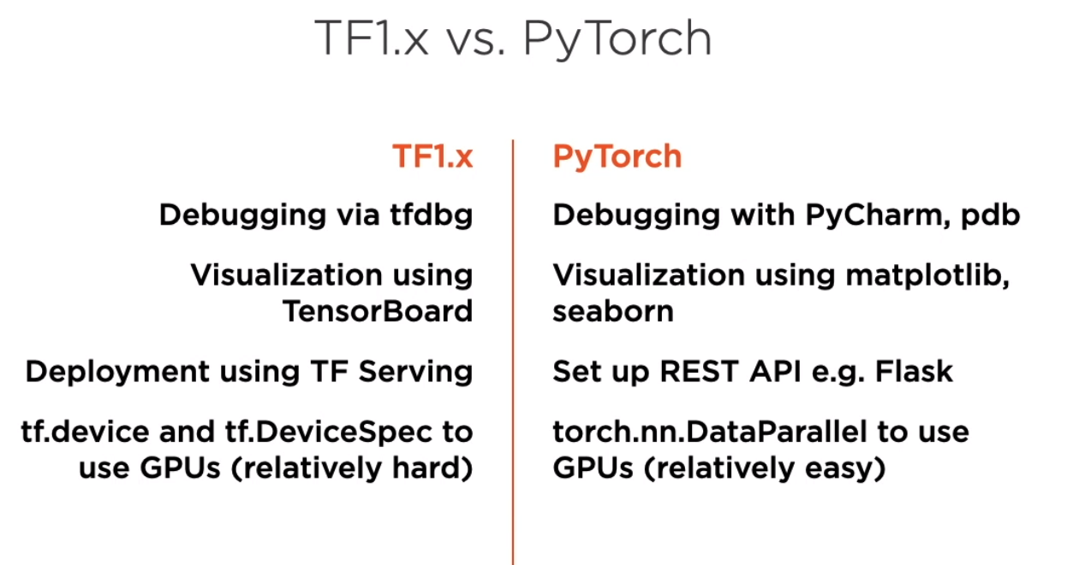
A. TensorFlow 1.x vs TensorFlow 2.0

Slide 10
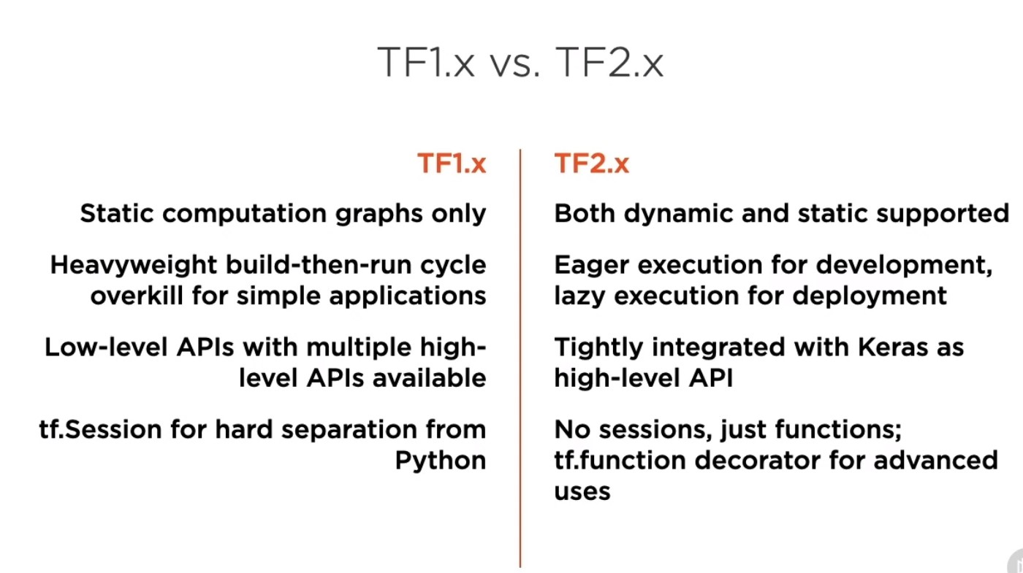

Slide 11
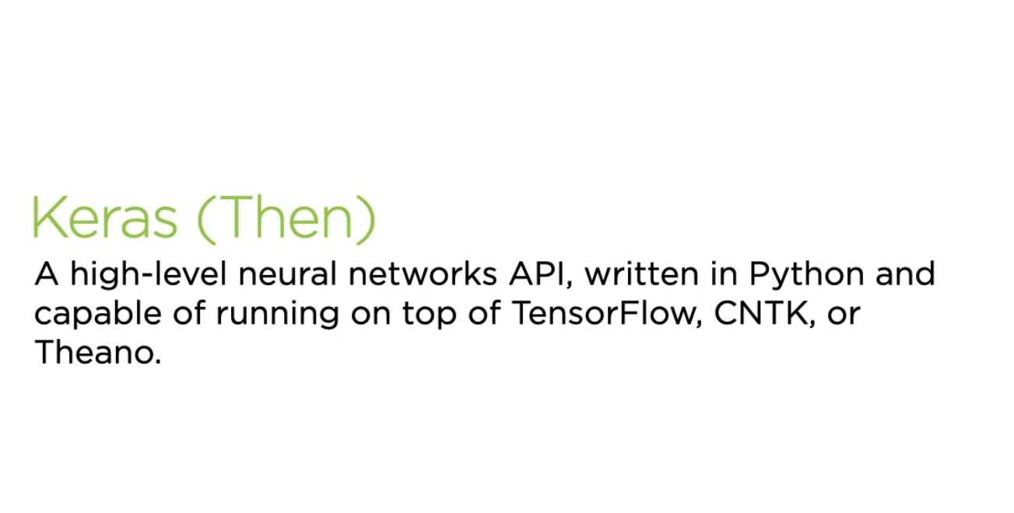
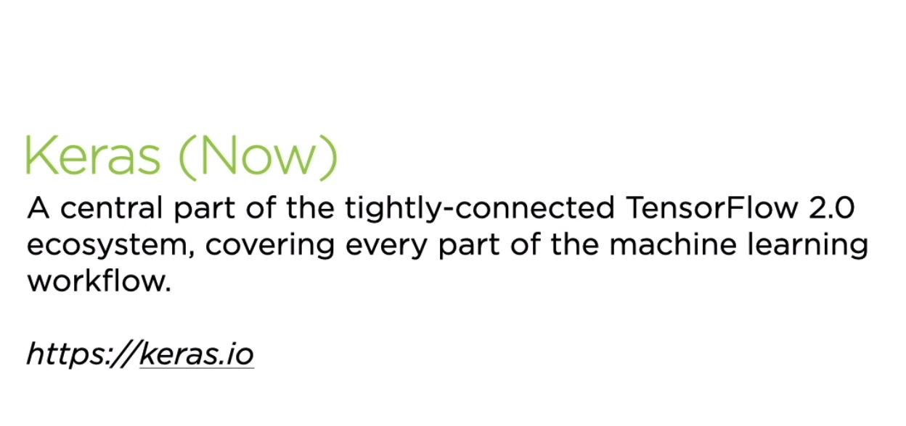

Slide 12
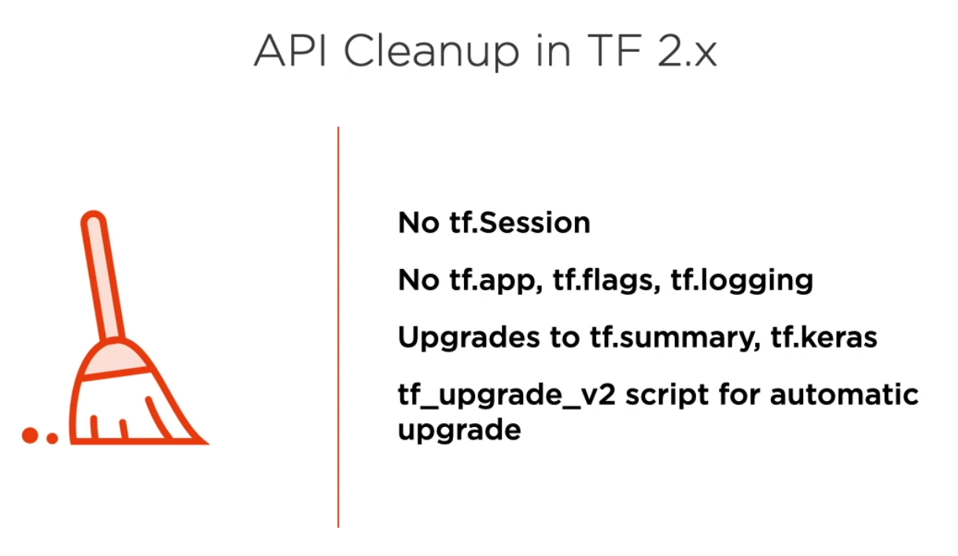
A. TensorFlow 1.x vs TensorFlow 2.0

Slide 13
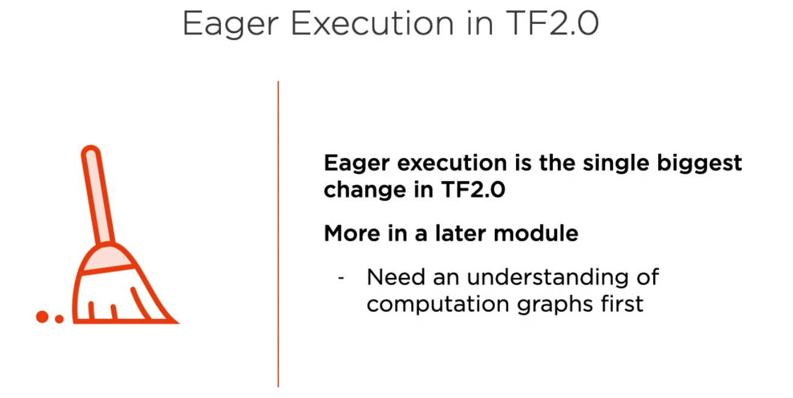
A. TensorFlow 1.x vs TensorFlow 2.0

Slide 14

B. Introducing Neural Networks

Slide 15
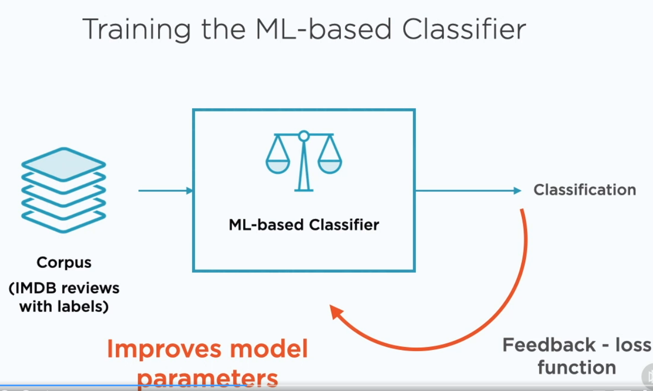
B. Introducing Neural Networks

Slide 16
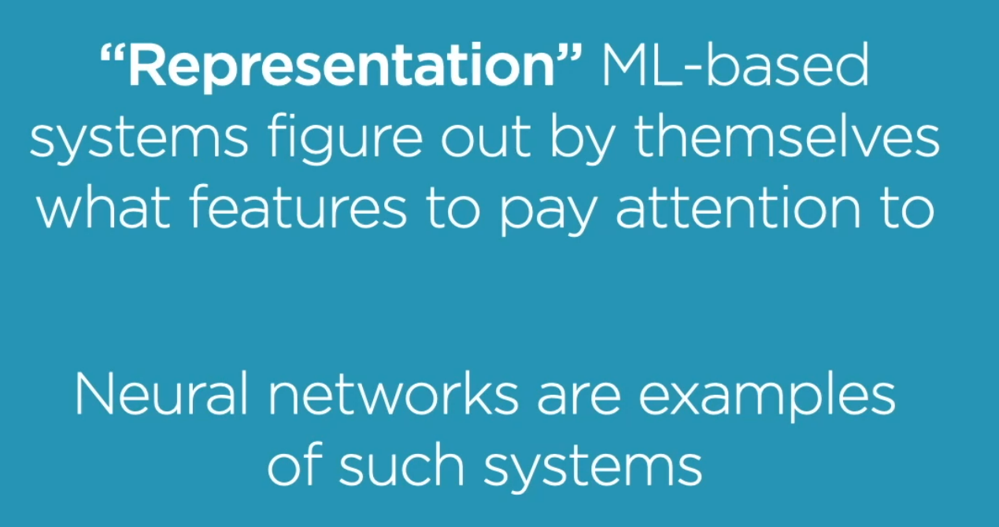
B. Introducing Neural Networks

Slide 17
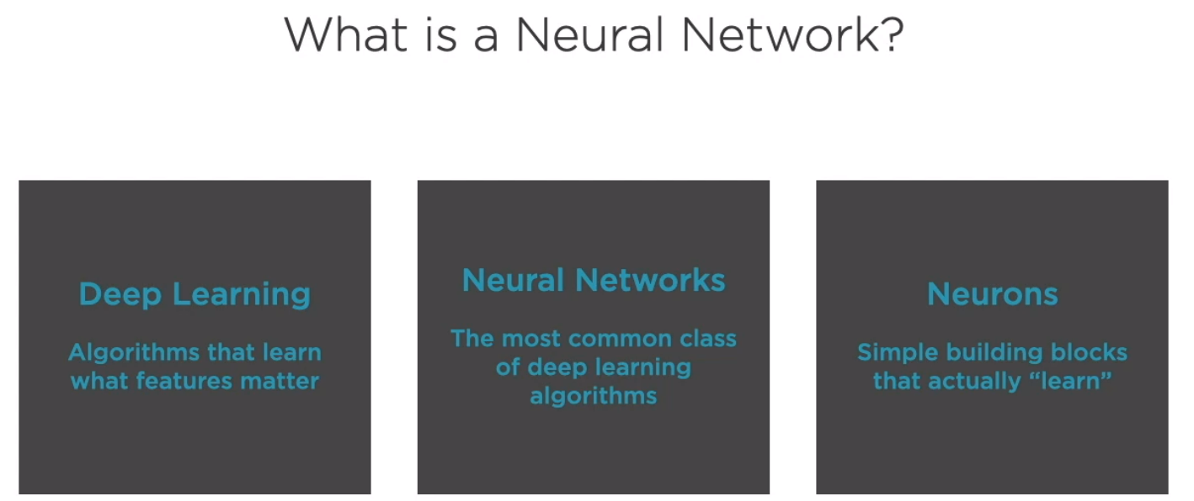
B. Introducing Neural Networks

Slide 18
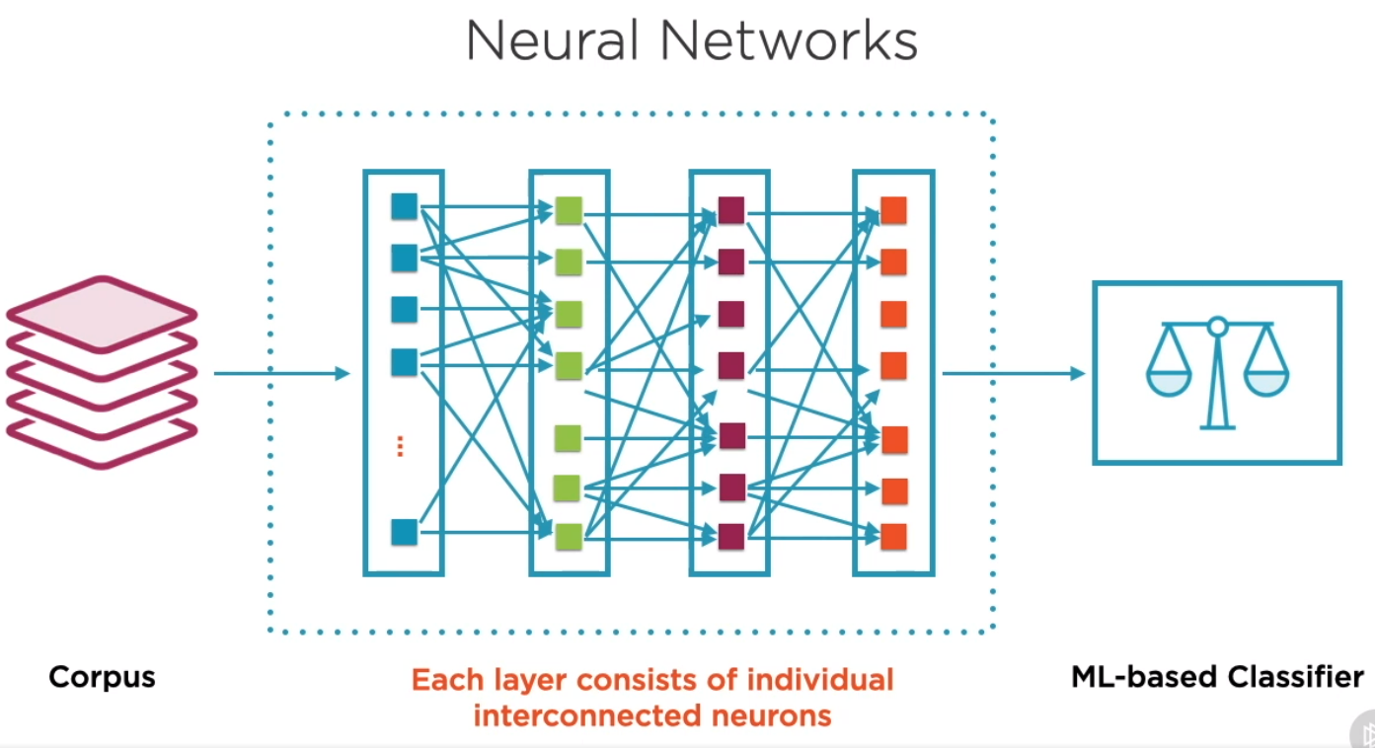
B. Introducing Neural Networks

Slide 19
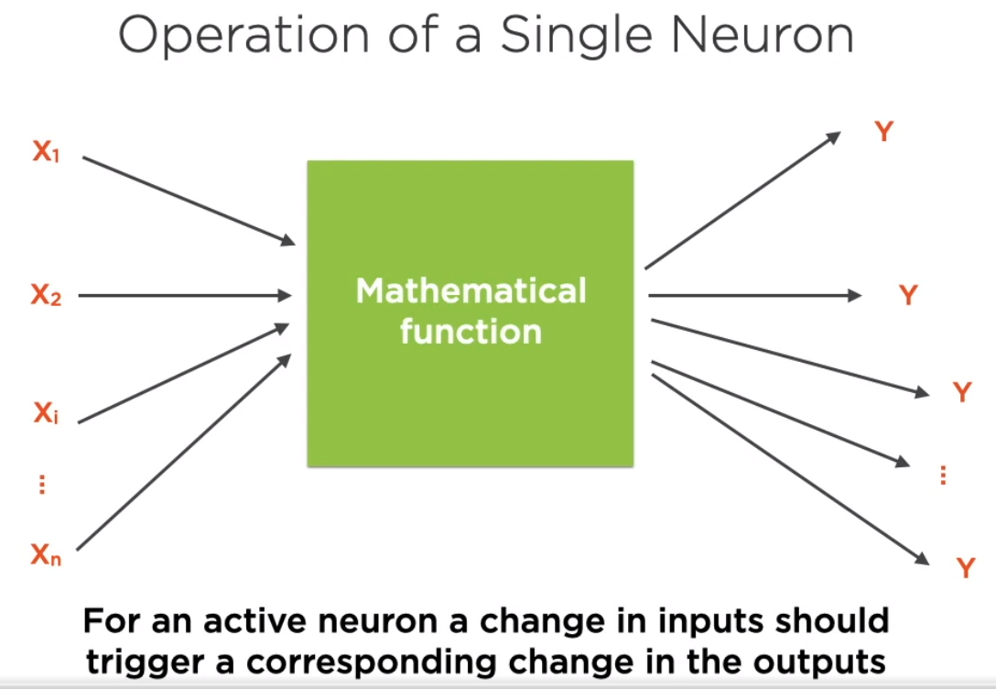
C. Neurons and Activation Functions

Slide 20
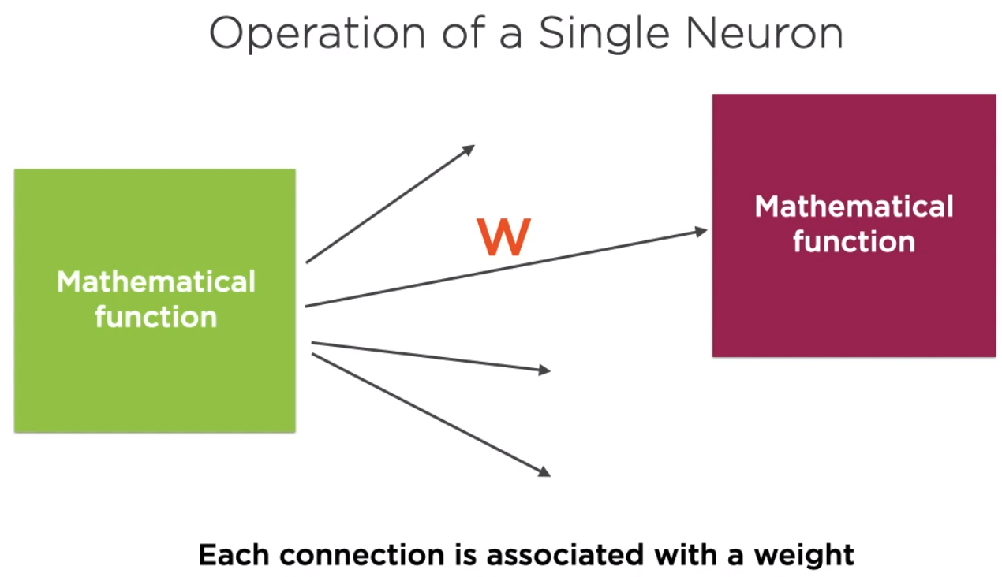
C. Neurons and Activation Functions

Slide 21
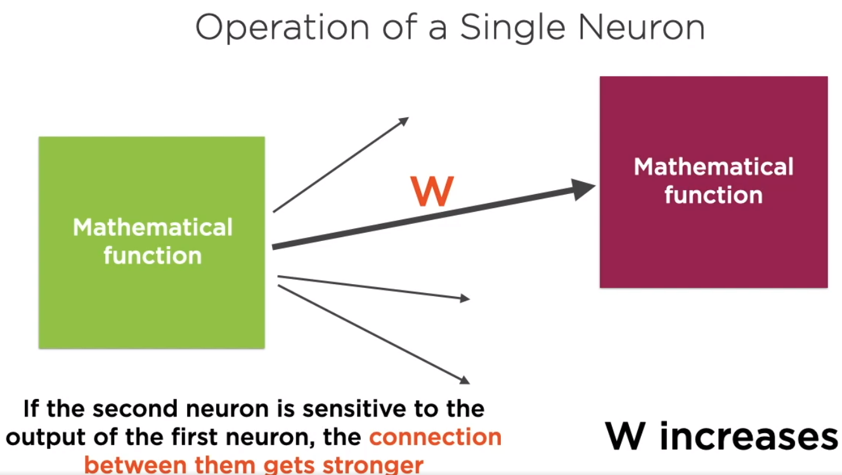
C. Neurons and Activation Functions

Slide 22
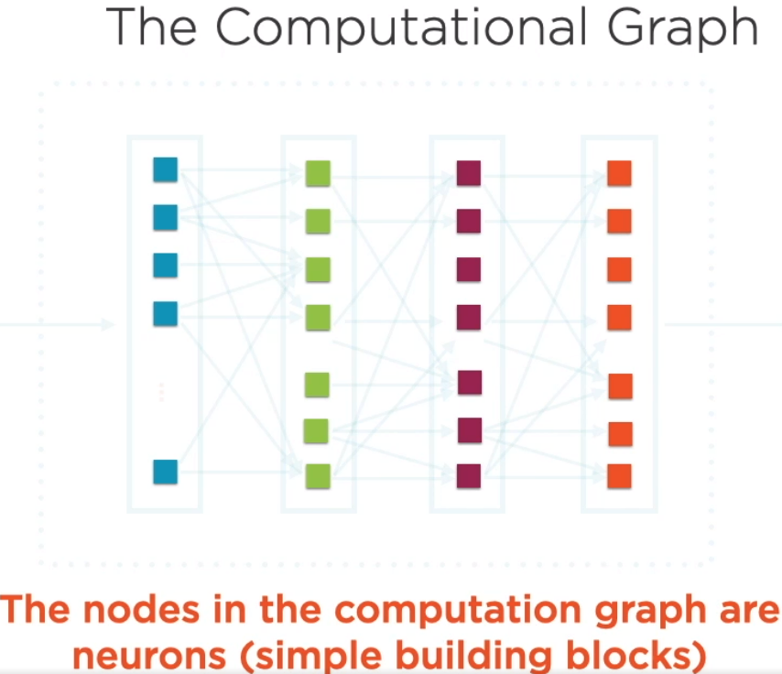
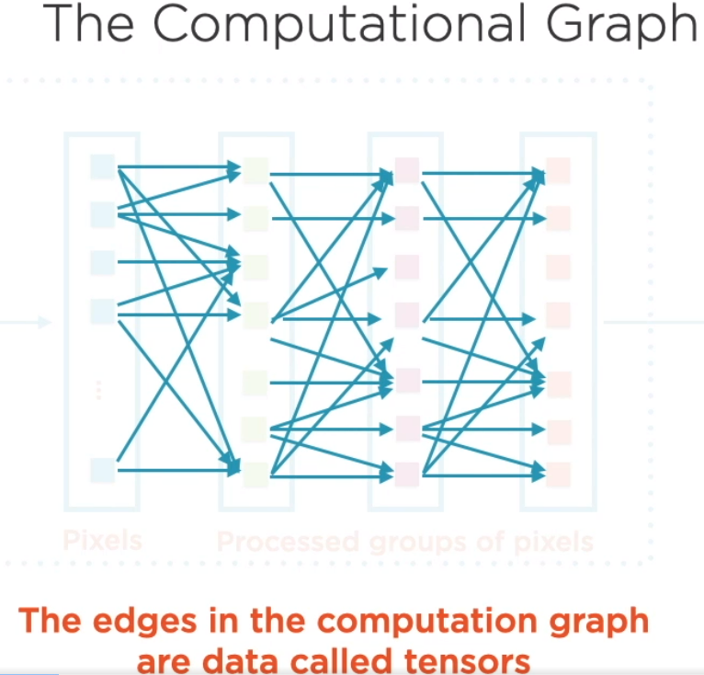
C. Neurons and Activation Functions

Slide 23
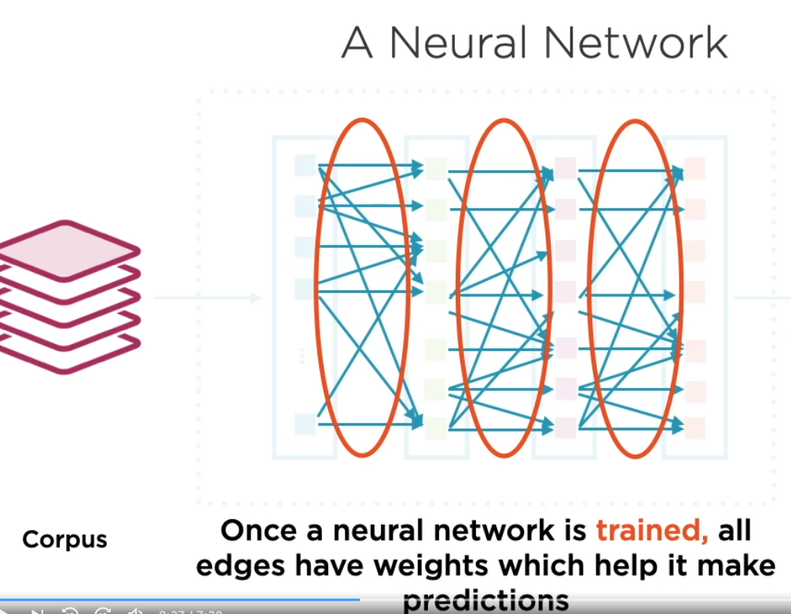
C. Neurons and Activation Functions

Slide 24
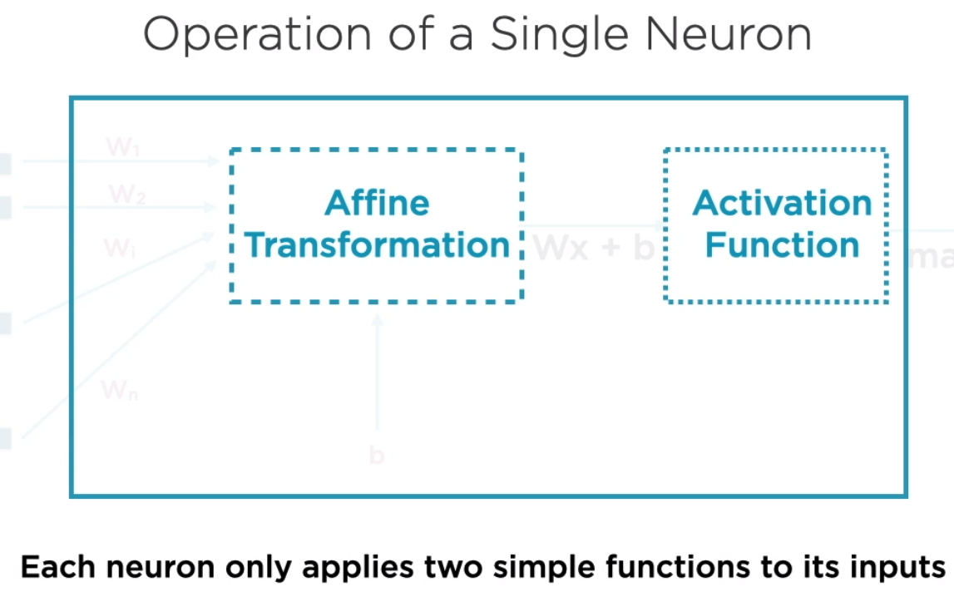
C. Neurons and Activation Functions

Slide 25
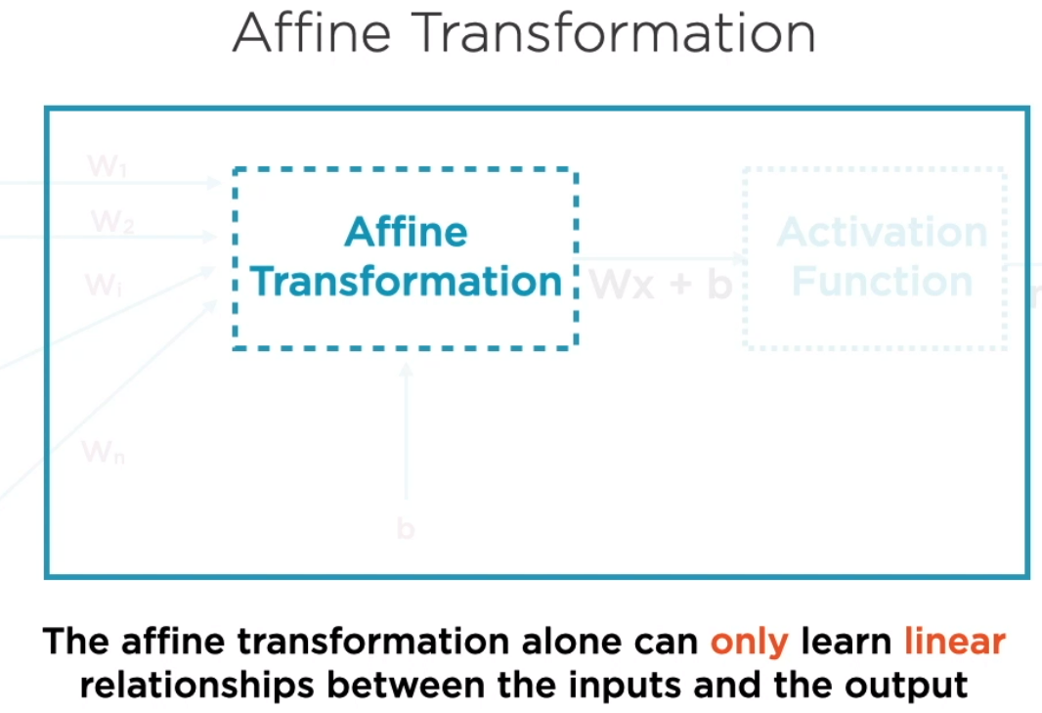
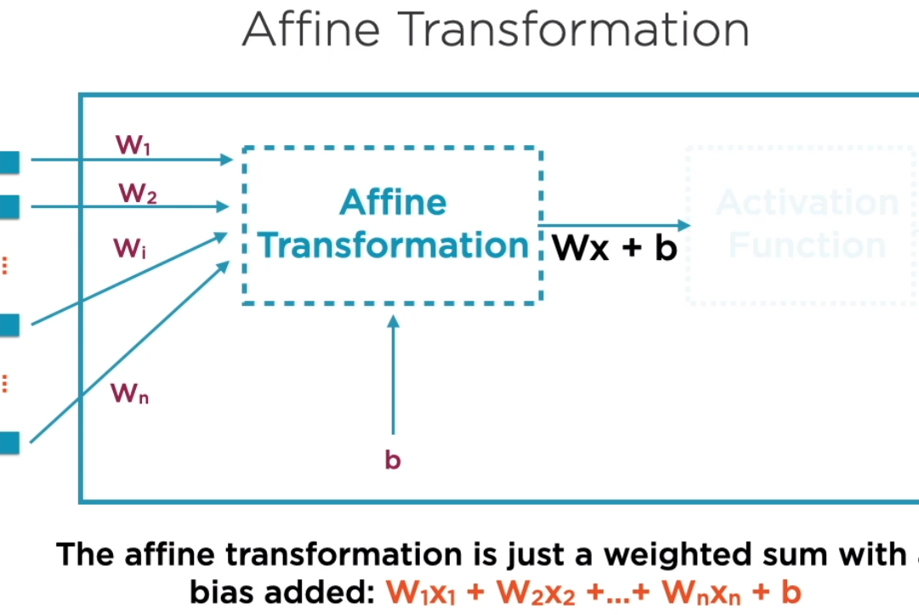
C. Neurons and Activation Functions

Slide 26
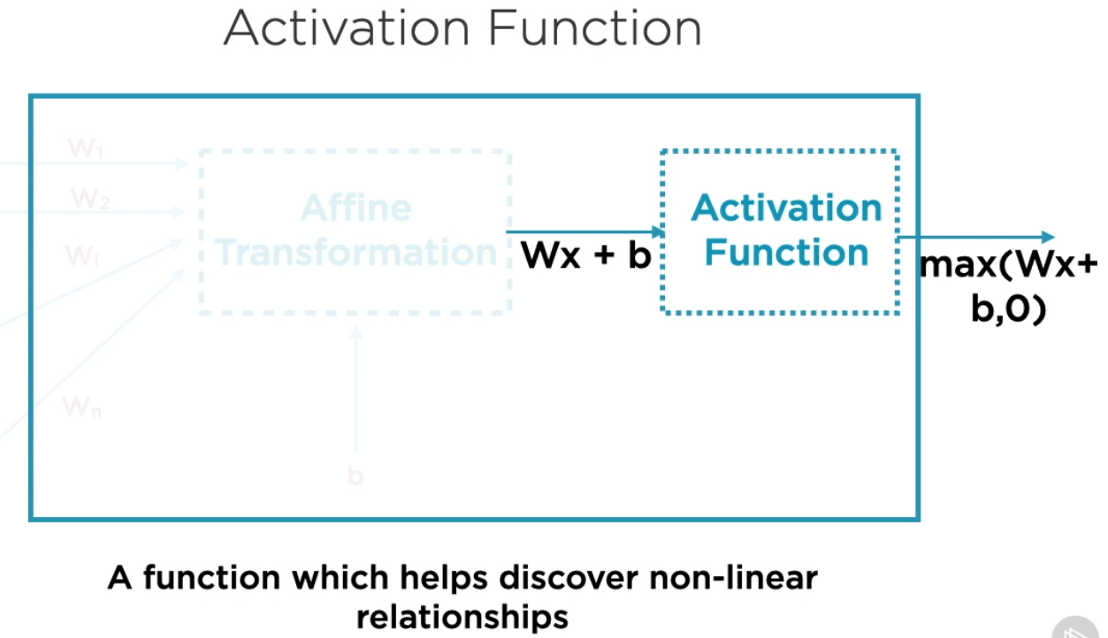
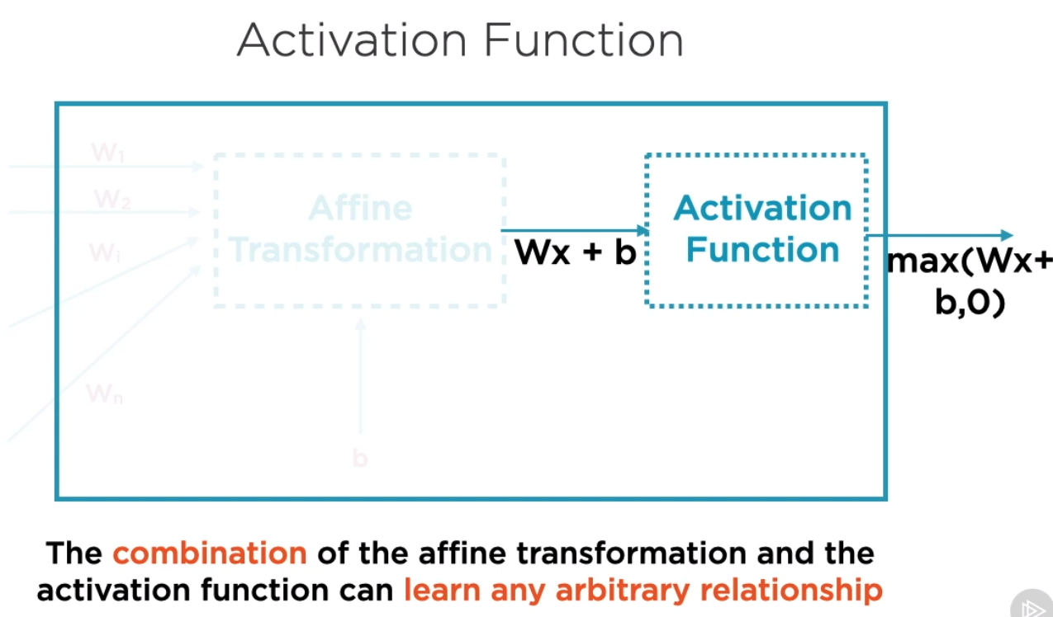
C. Neurons and Activation Functions

Slide 27
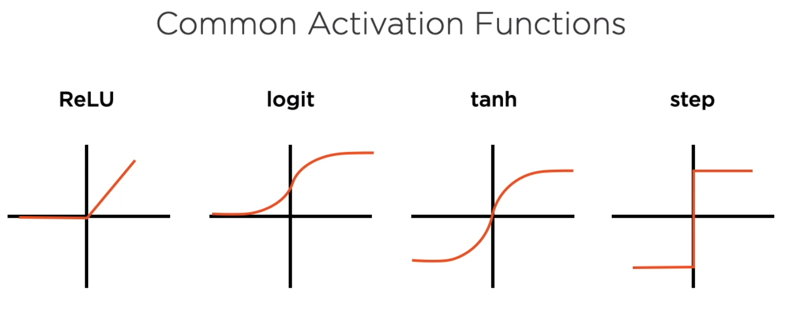
C. Neurons and Activation Functions

Slide 28
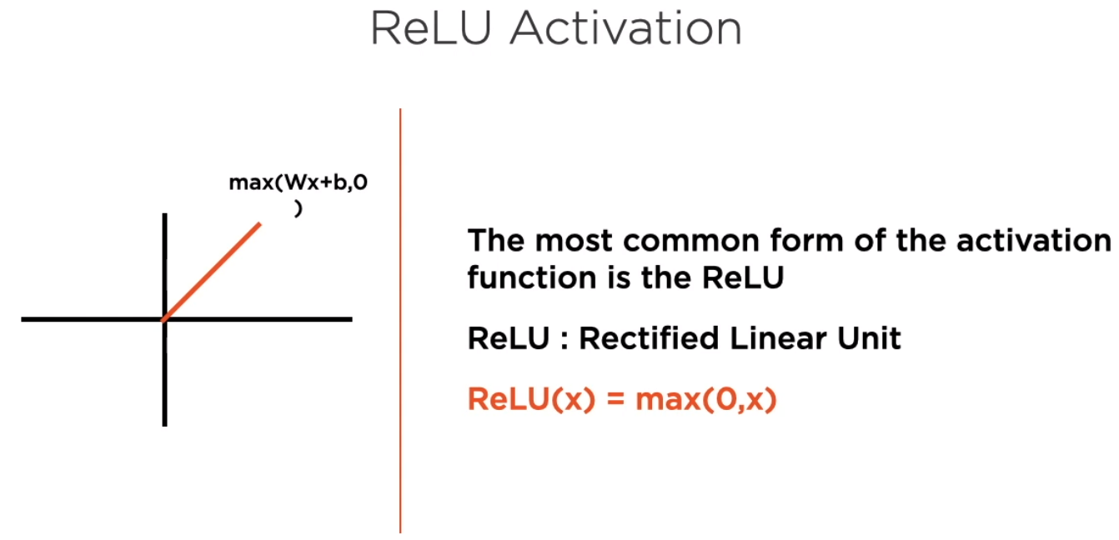
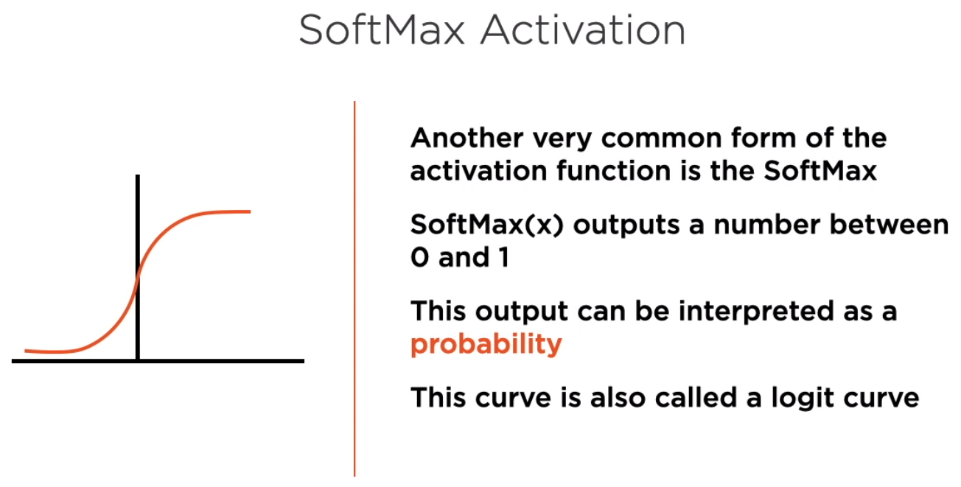
C. Neurons and Activation Functions

Slide 29
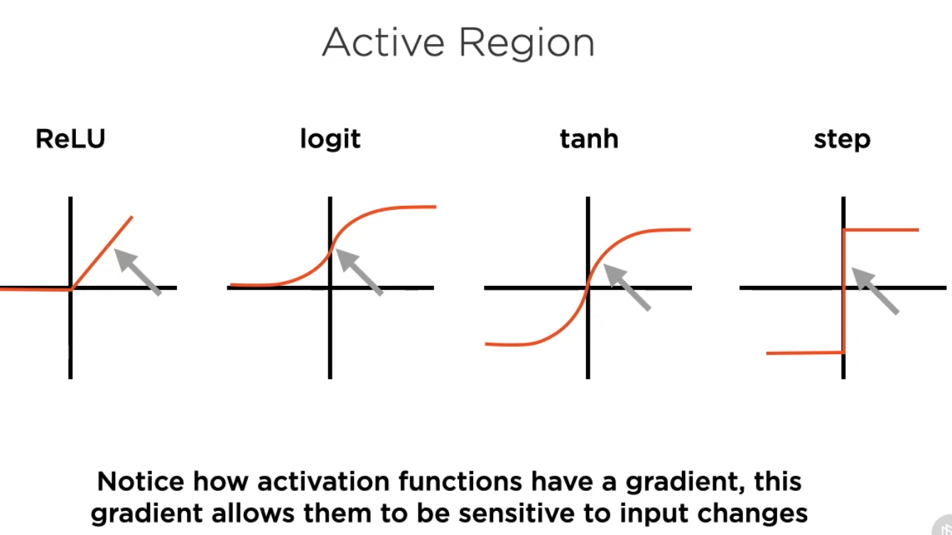
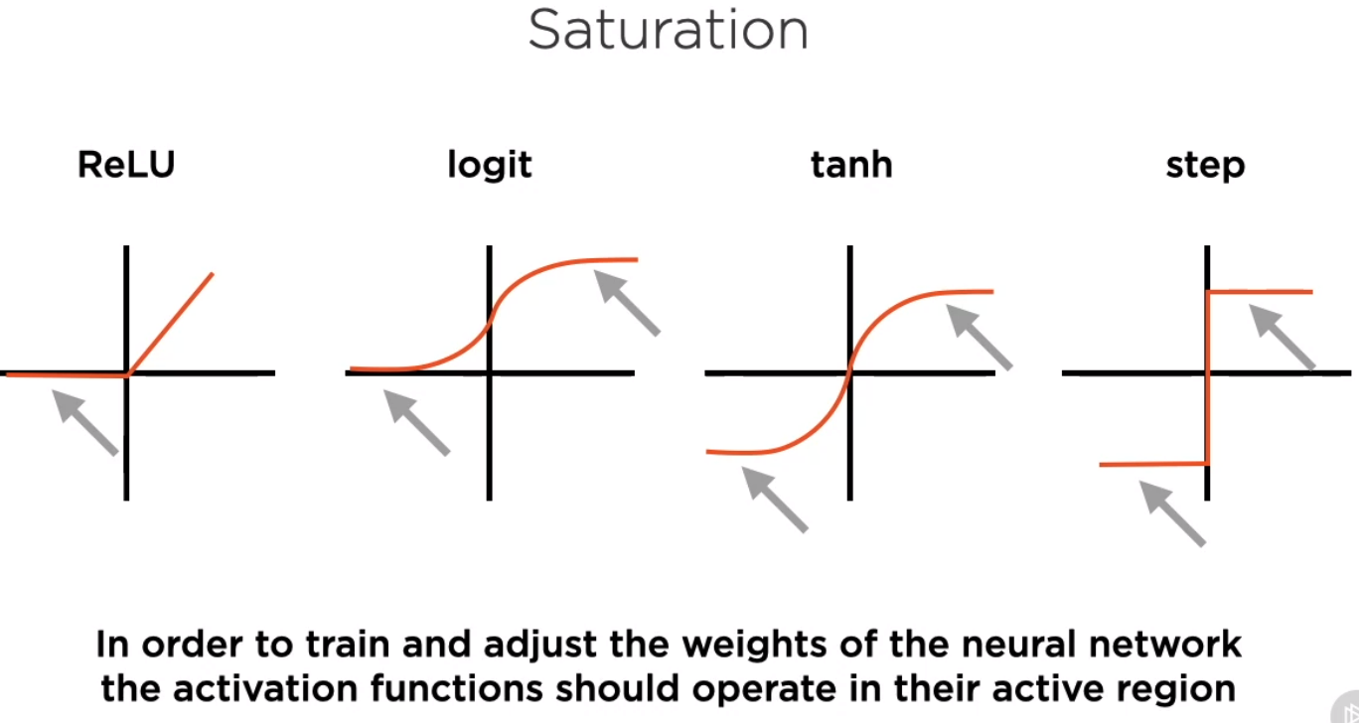
C. Neurons and Activation Functions

Slide 30
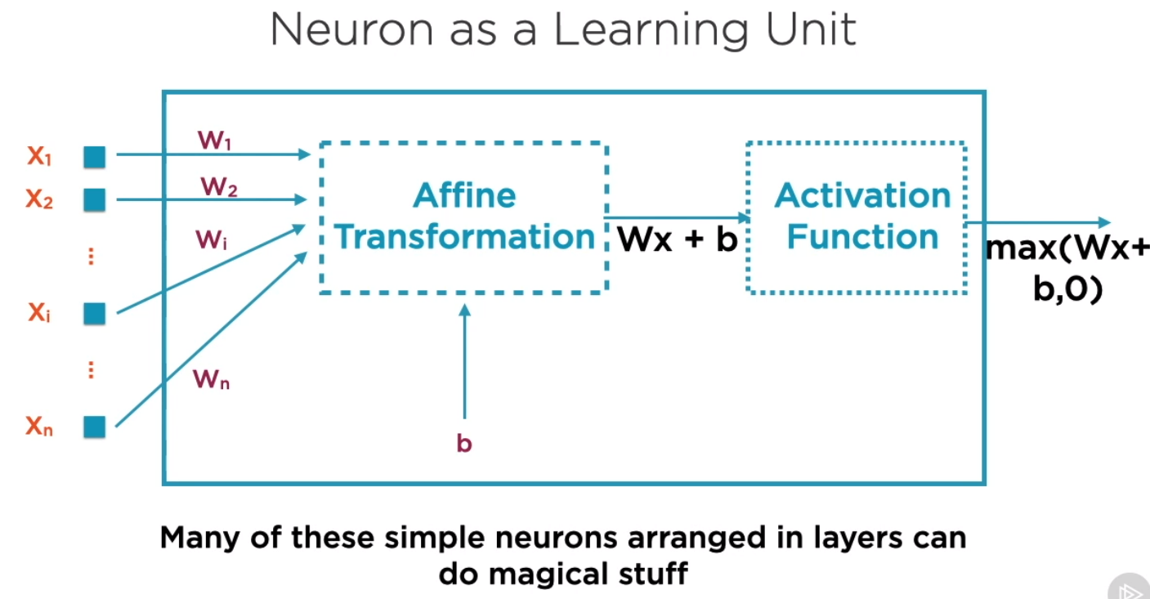
C. Neurons and Activation Functions

Slide 31
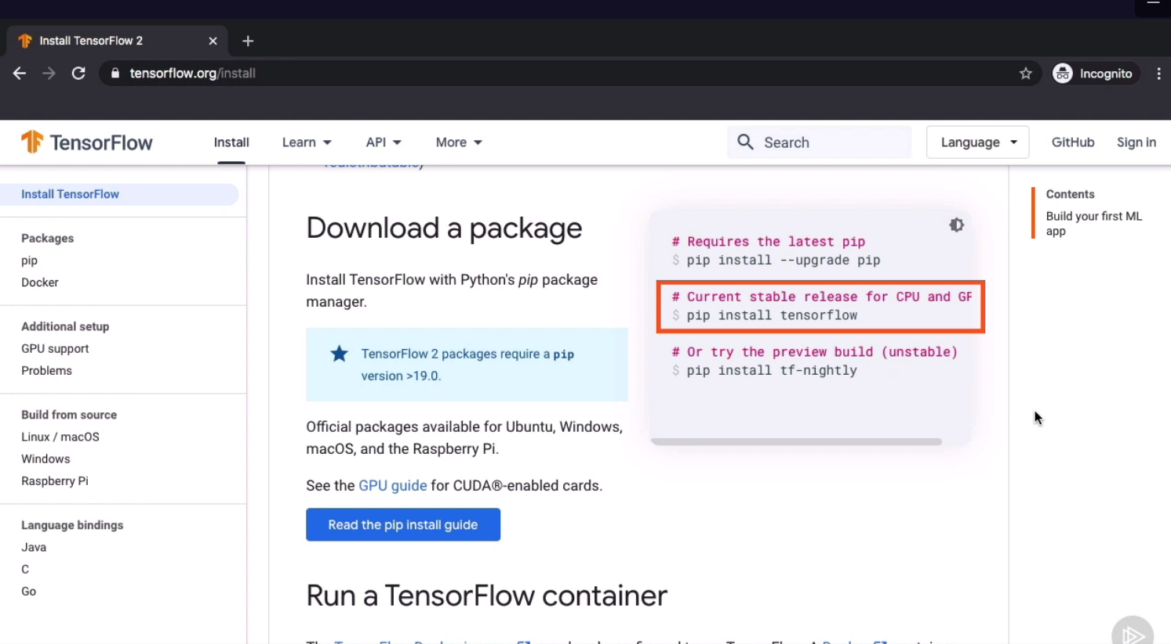
D. Working with Tensors and Variables

Slide 32
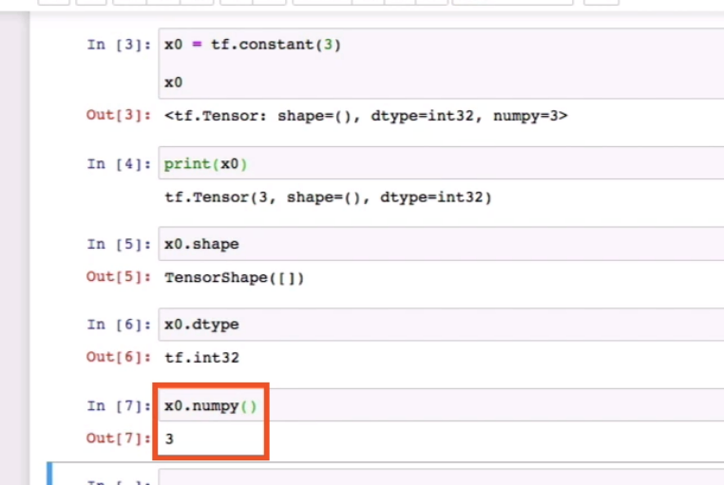
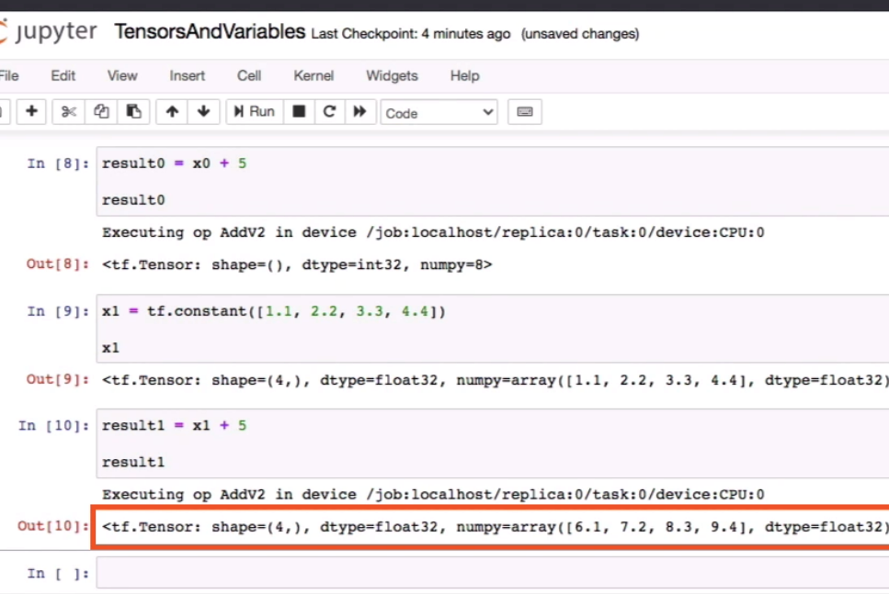
D. Demo: Working with Tensors

Slide 33
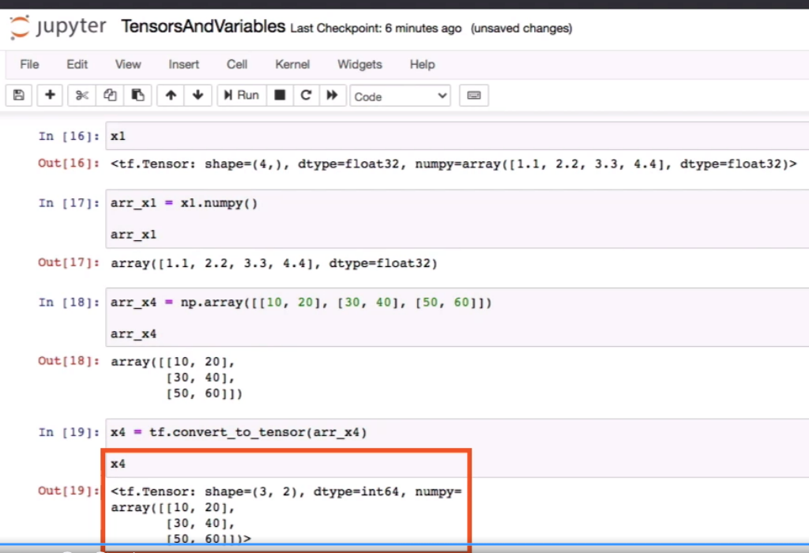
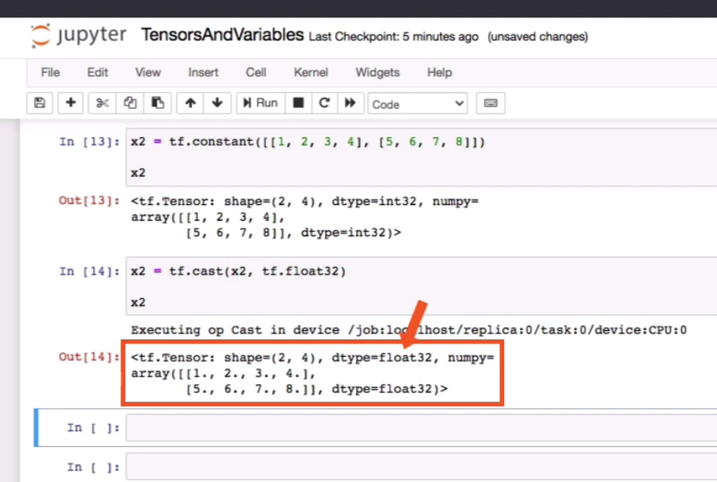
D. Demo: Working with Tensors

Slide 34
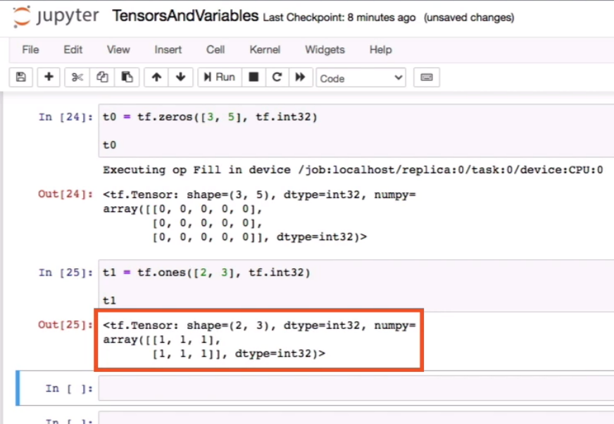
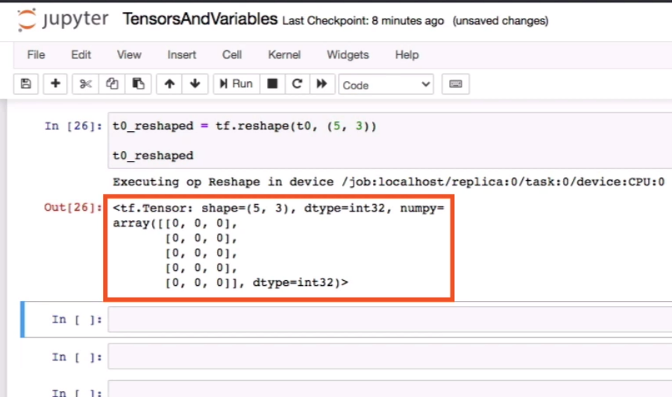
D. Demo: Working with Tensors

Slide 35
D. Demo: Working with Variables

Slide 36
D. Working with Variables

Slide 37
